Slide 1
Discussion 5
Trees, Mutation & Non-local
Jason Zhou | Section 136
CS61A Spring 2019

Slide 2
Anonymous
Feedback
links.cs61a.org/jasonz-feedback

Slide 3
Announcements
Today: Lab 05 Due
HW04 Due

Slide 4
Agenda
Trees
Lists/Mutation
Lists Exam Practice
Non-local

Slide 5
Trees

Slide 6

Tree ADT
Recursive Data Structure
A tree: One root/label, and a list of trees as its branches
Key Terminology
Parent Node
Child Node
Root
Label
Leaf
Branch
Depth
Height

Slide 7
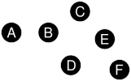
Tree ADT
Each node has at most 1 parent
Tree with n nodes has exactly n - 1 edges
Proof:
All nodes have 1 parent except for the root
n -1 nodes have parents
Definition of parent: connected by an edge
n -1 edges

Slide 8
Applications of Trees
Binary Tree
Tree where every node has at most 2 children
K-ary Tree
Tree where every node has at most k children
Bushy: every node has lots of children
Binary Search Tree (BST)
Every label in the right subtree is bigger than the root
Every label in the left subtree is smaller than the root
The above two properties hold for all nodes in the tree
For a BST, search is extremely fast (Lecture: Growth)
Introduction:
For a full binary tree with n nodes, (where every node has two children except for the leaves)
Approximately how many nodes are leaves?
What is the depth of the tree?
If there are n nodes, how many comparisons do I need to make?
How many comparisons for an unsorted list of n values?
We will quantify this in lecture next week using asymptotic analysis (Lecture on Growth)

Slide 9
Trees & Tree Recursion Paradigm
Maximum value in a tree:
Root value, or one of the maximum values of each branch
Finding a value in a tree:
Either find it at the root, or in one of the branches
Maximum depth of a tree:
Maximum depth of branches + 1
Tree: Recursive data structure
Problems with trees: generally easiest with recursive approach

Slide 10
Lists/Mutation

Slide 11
List Mutation
J = L + K
Makes a new list J that is the elements of L, then elements of K
L.append(x)
Adds x as the last element of L
L.extend(x)
Adds the elements of x as the last elements of L
L += x

Slide 12
List Mutation
L.insert(i, el):
Inserts element el at index i in L
L.remove(el):
Removes first occurence of element el in L
L.pop(i):
Removes and returns the element at index i

Slide 13
List Mutation
L is K
Returns True if L and K are the exact same list object
L == K
Returns True if L and K are lists that have the same elements in order
L[i:j]
Splice; returns copy of L from element i to j-1
L[:]
Returns copy of L

Slide 14
Box-and-Pointer Diagrams
List of length n:
n boxes
Each box represents value at each index
If value is a list: must use a pointer to point to list
>>> a = [1, 2, 3, 4]
>>> [“a”, [4, 3]]
>>> [a, 5]

Slide 15
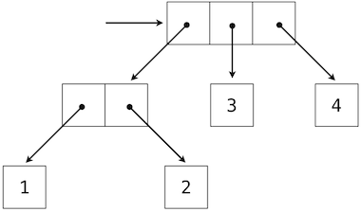
Box-and-Pointer Diagrams
b = [ [ [1], [2] ], [3], [4] ]
b

Slide 16
Lists
Exam Practice

Slide 17
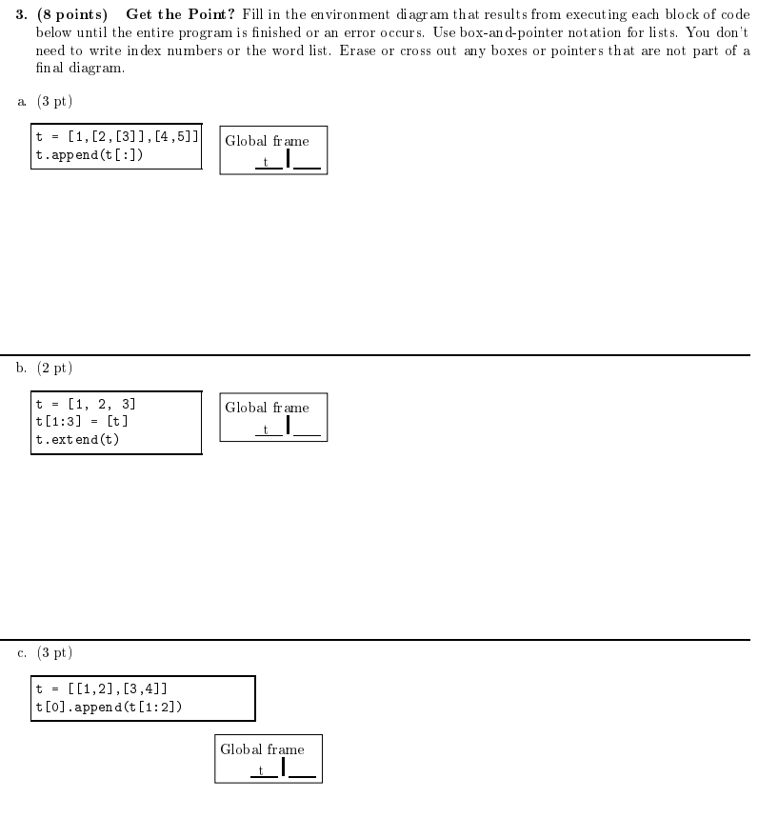

Slide 18
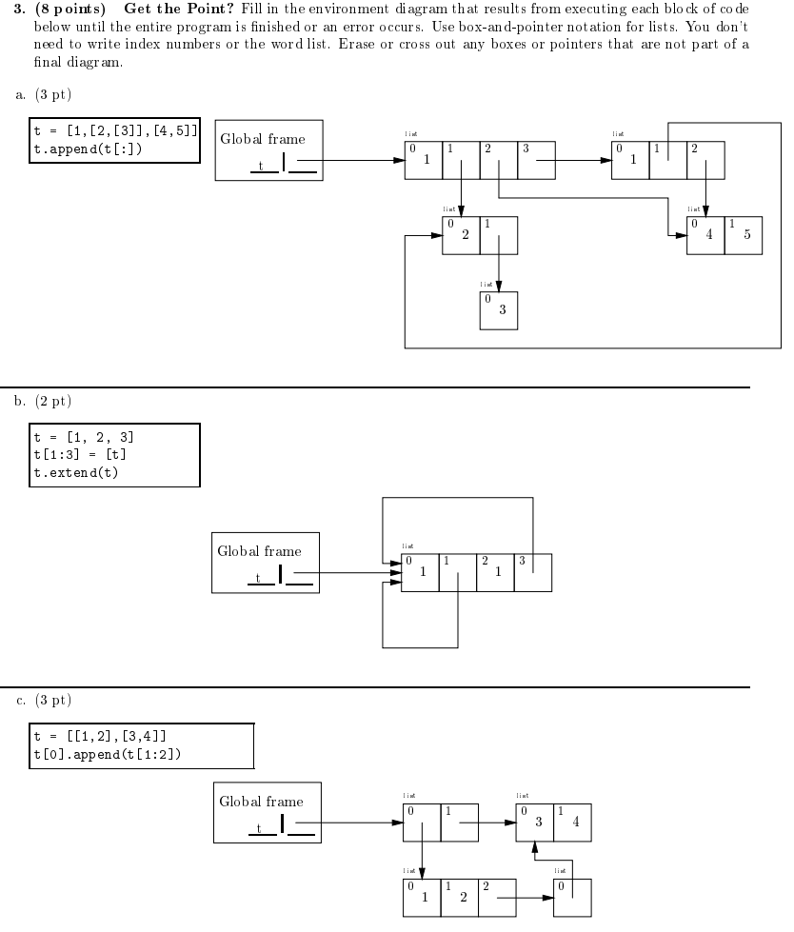

Slide 19
Nonlocal & Mutable Functions

Slide 20
Nonlocal & Mutable Functions
Recall:
When doing a variable lookup:
Look in current, local flame
Look in parent frame
Look in parent frame’s parent frame
etc.
Can only ever change the value of a variable in current frame.
Using the nonlocal keyword:
Change the value of a nonlocal variable in a parent frame.*
*Excludes variables in global frame, variables already in local frame
Mutable function: function that uses non-local

Slide 21
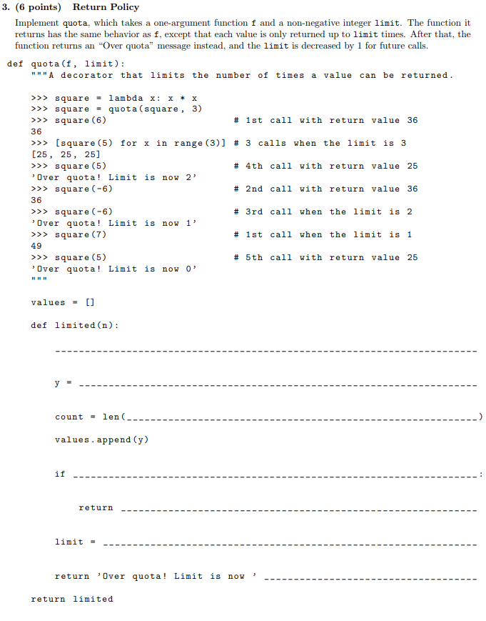

Slide 22
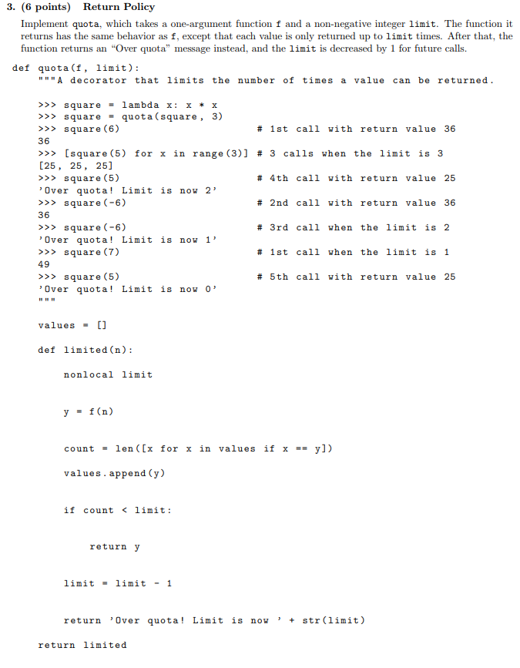

Slide 23
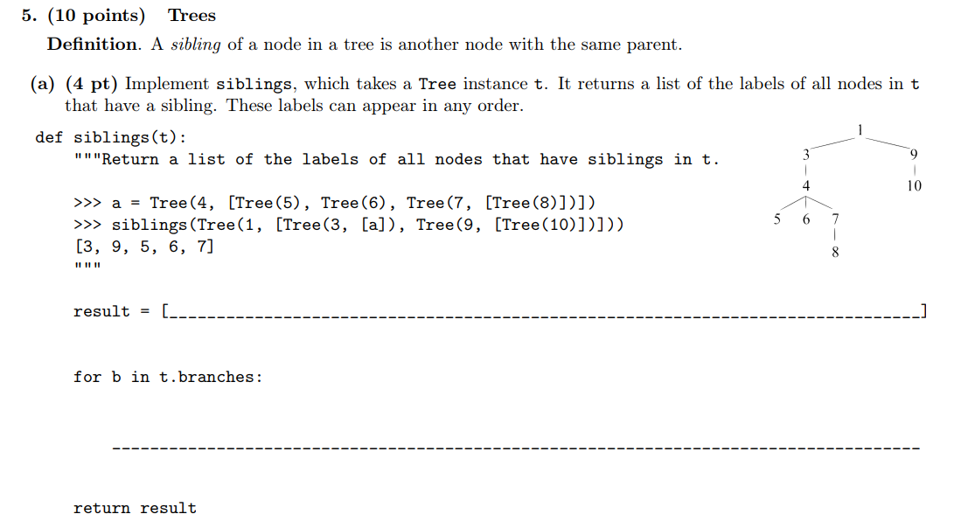

Slide 24
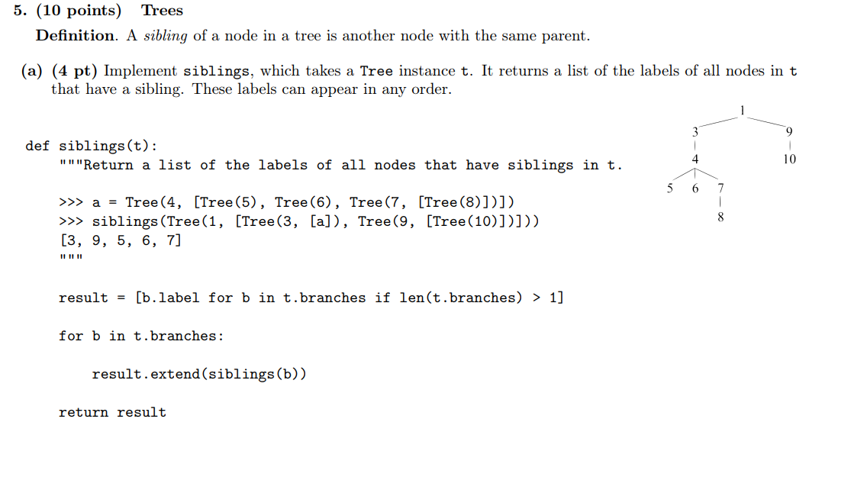

Slide 25
Attendance
links.cs61a.org/jasonz-attendance

